Slide 1
Scrapy Project: Microsoft App Store
08/08/2018
By Jensen Hu

Slide 2
Table of Contents
Introduction
Scrapy Flow Diagram
What was scraped?
Summary of Results

Slide 3
Table of Contents
Introduction
Scrapy Flow Diagram
What was scraped?
Summary of Results

Slide 4
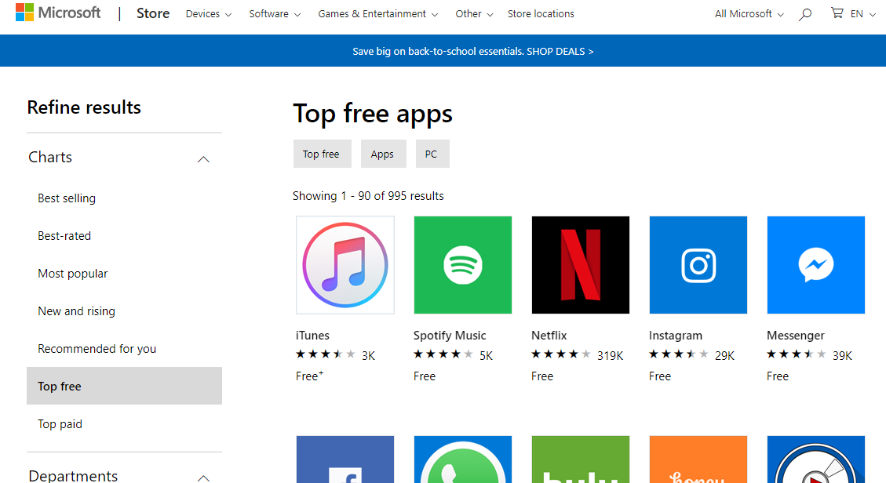
Introduction
Objective: scrape the Microsoft App store to explore the contents, ratings, reviews, overall app community.

Slide 5
Table of Contents
Introduction
Scrapy Flow Diagram
What was scraped?
Summary of Results

Slide 6
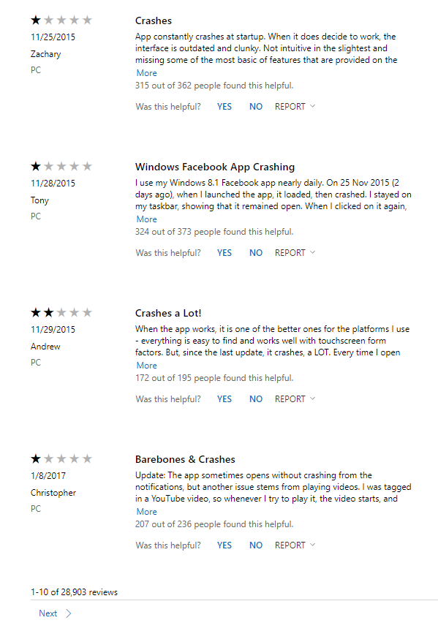
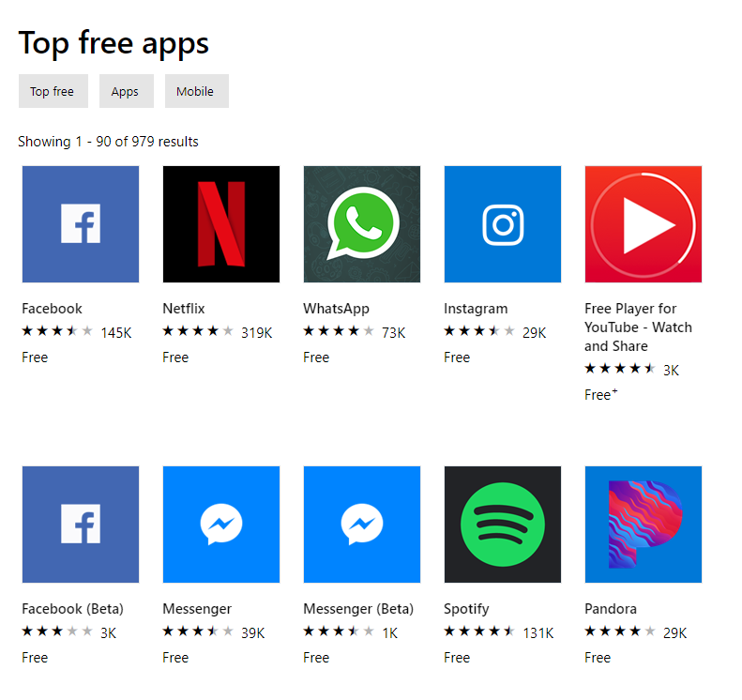
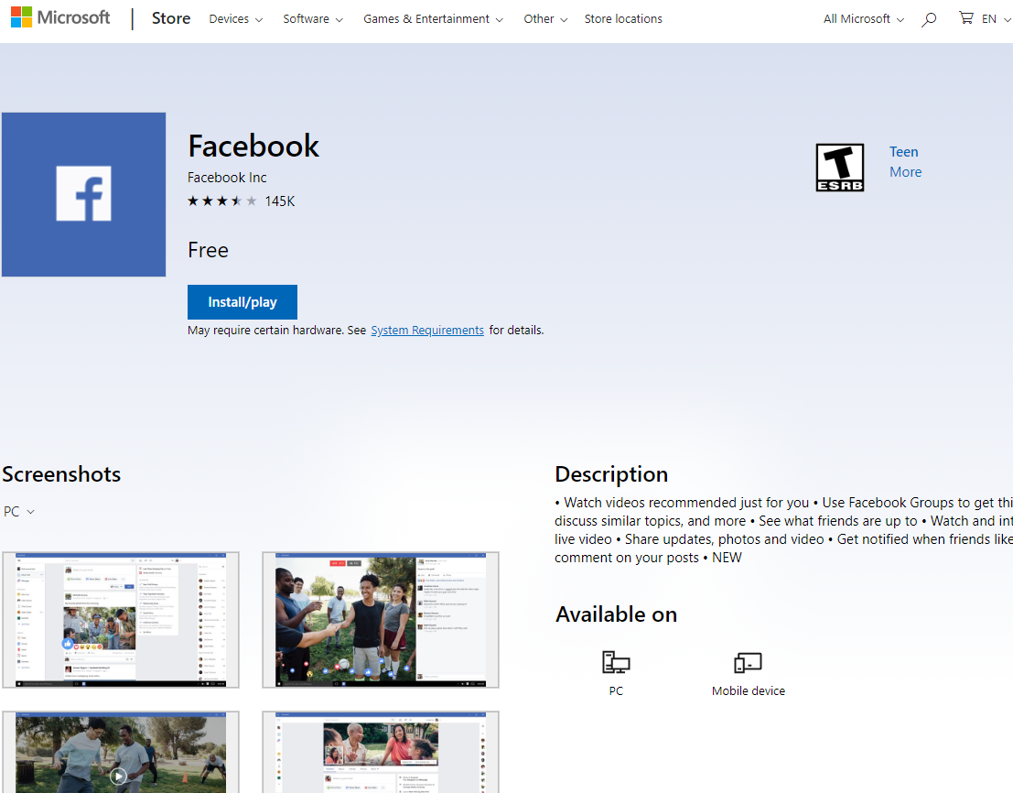
Scrapy Flow Diagram
Individual Comment Rating
App Name
ESRB Rating
Comment Header

Slide 7
Table of Contents
Introduction
Scrapy Flow Diagram
What was scraped?
Summary of Results

Slide 8
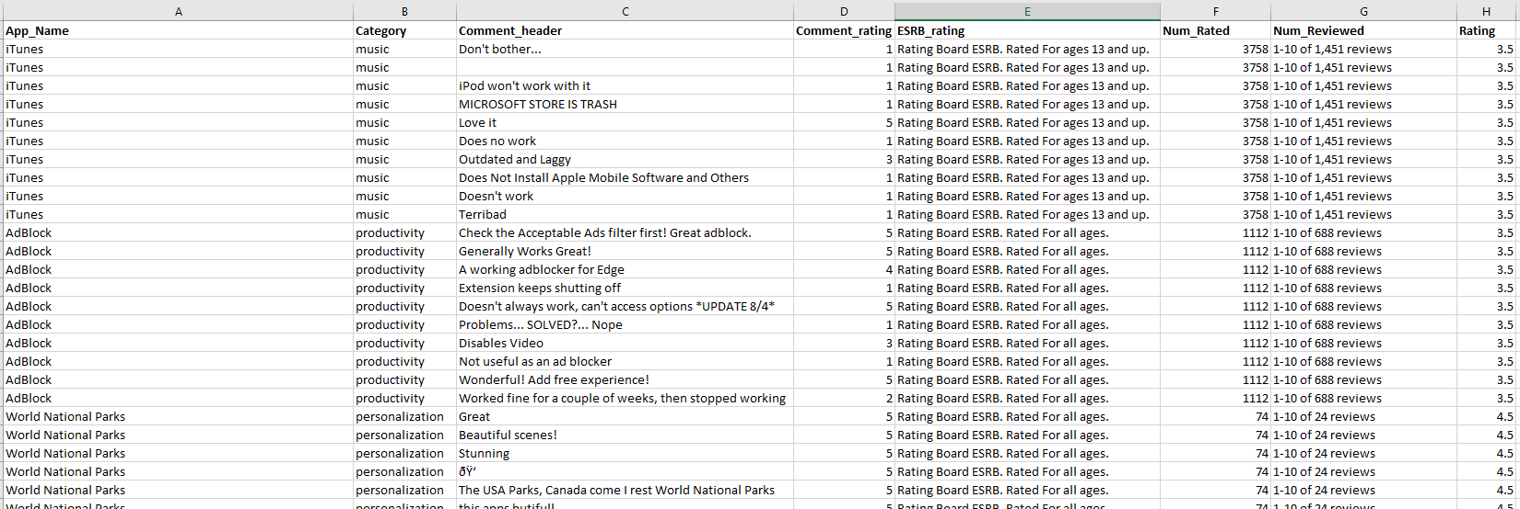
What was Scraped?

Slide 9
Table of Contents
Introduction
Scrapy Flow Diagram
What was scraped?
Summary of Results

Slide 10
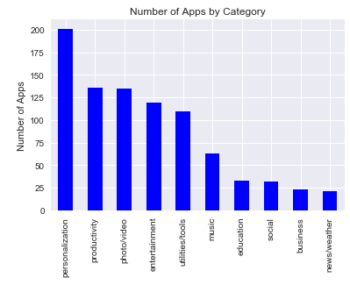
Summary of Results
Scraped 873 apps
Categories with > 20 apps

Slide 11
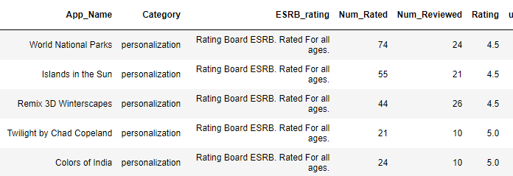
Summary of Results: Personalization Apps

Slide 12
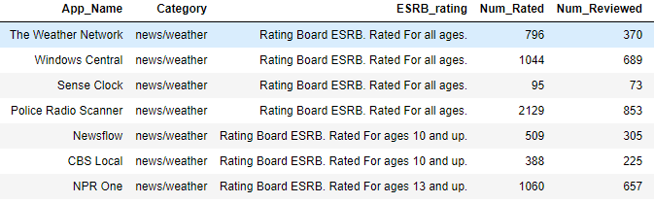
Summary of Results: News/Weather Apps

Slide 13
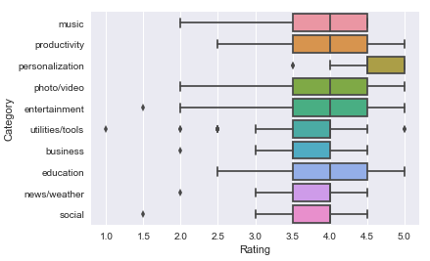
Summary of Results: Ratings by Category

Slide 14
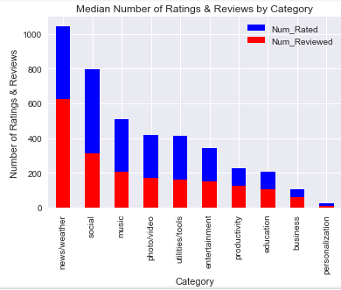
Summary of Results: Number of Ratings & Reviews

Slide 15
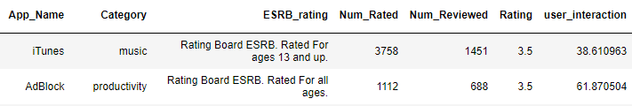
Summary of Results: User Interaction
User interaction: Number of Reviews / Number of Ratings

Slide 16
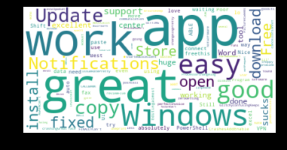
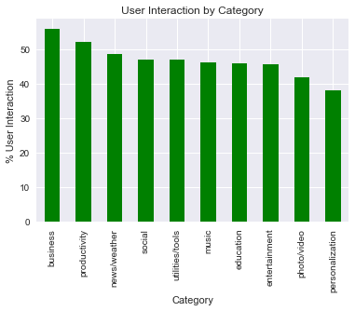
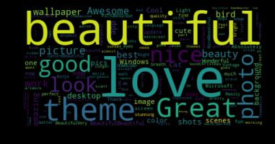
Summary of Results: User Interaction
Business WordCloud
Personalization WordCloud

Slide 17
Questions?

